Slide 1
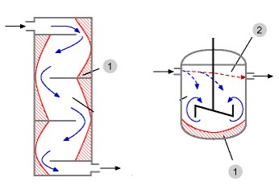
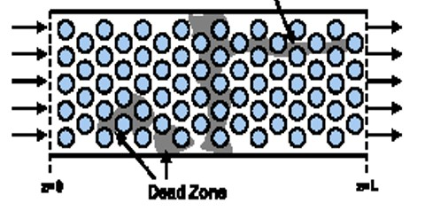
Review: Nonideal Flow & Reactor Design
Real CSTRs
  Relatively high reactant conc at entrance
  Relatively low conc in stagnant regions, called dead zones (corners & behind baffles)
Real PBRs
fluid velocity profiles, turbulent mixing, & molecular diffusion cause molecules to move at varying speeds & directions
Short Circuiting
channeling
Dead Zone
Dead zones
Dead Zone
Goal: mathematically describe non-ideal flow and solve design problems for reactors with nonideal flow

Slide 2
Residence Time Distribution (RTD)
RTD ≡ E(t) ≡ “residence time distribution” function
RTD describes the amount of time molecules have spent in the reactor
RTD is experimentally determined by injecting an inert “tracer” at t=0 and measuring the tracer concentration C(t) at exit as a function of time
Measurement of RTD
The C curve
Reactor
X
C(t)
↑
Pulse injection
↓
Detection
t
E(t)=0 for t<0 since no fluid can exit before it enters
E(t)≥0 for t>0 since mass fractions are always positive
Fraction of material leaving reactor that has been inside reactor for a time between t₁ & t₂

Slide 3
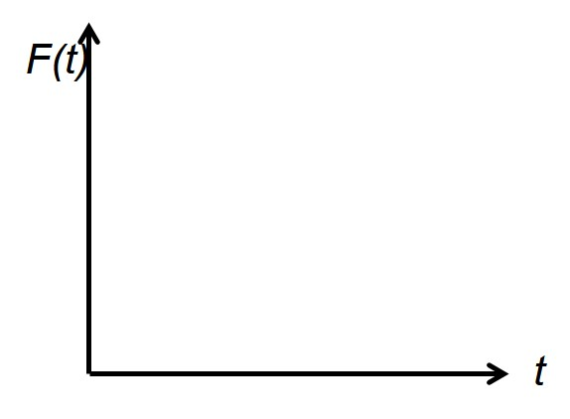
E(t)
E(t)
E(t)
E(t)
Nice multiple choice question
τ
t
t
τ
t
t
Nearly ideal PFR
Nearly ideal CSTR
PBR with dead zones
CSTR with dead zones
The fraction of the exit stream that has resided in the reactor for a period of time shorter than a given value t:
F(t) is a cumulative distribution function
0.8
80% of the molecules spend 40 min or less in the reactor
40

Slide 4
Review: Mean Residence Time, t_{m}
For an ideal reactor, the space time τ is defined as V/υ₀
The mean residence time t_{m} is equal to τ in either ideal or nonideal reactors
By calculating t_{m}, the reactor V can be determined from a tracer experiment
The spread of the distribution (variance):
Space time τ and mean residence time t_{m} would be equal if the following two conditions are satisfied:
  No density change
  No backmixing
In practical reactors the above two may not be valid, hence there will be a difference between them

Slide 5
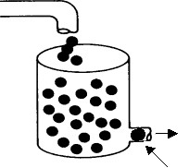
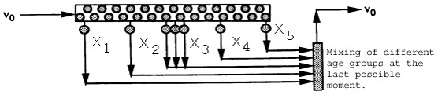
Review: Complete Segregation Model
Mixing of different ‘age groups’ at the last possible moment
  Flow is visualized in the form of globules
  Each globule consists of molecules of the same residence time
  Different globules have different residence times
  No interaction/mixing between different globules
The mean conversion is the average conversion of the various globules in the exit stream:
Conversion achieved after spending time t_{j} in the reactor
Fraction of globules that spend between t_{j} and t_{j} + Δt in the reactor
X_{A}(t) is from the batch reactor design equation

Slide 6
Review: Maximum Mixedness Model
In a PFR: as soon as the fluid enters the reactor, it is completely mixed radially with the other fluid already in the reactor. Like a PFR with side entrances, where each entrance port creates a new residence time:
λ →∞
λ → 0
υ₀
V = 0
λ +Δλ
λ
V = V₀
λ: time it takes for fluid to move from a particular point to end of the reactor
υ(λ): volumetric flow rate at λ, = flow that entered at λ+Δλ plus what entered through the sides
υ₀E(λ)Δλ: Volumetric flow rate of fluid fed into side ports of reactor in interval between λ + Δλ & λ
Volumetric flow rate of fluid fed to reactor at λ:
fraction of effluent that in reactor for less than time t
Volume of fluid with life expectancy between λ + Δλ & λ:

Slide 7
For a pulse tracer expt, the effluent concentration C(t) & RTD function E(t) are given
in the table below. The irreversible, liquid-phase, nonelementary rxn A+B→C+D, -r_{A}=kC_{A}C_{B}² will be carried out isothermally at 320K in this reactor. Calculate the conversion for (1) an ideal PFR and (2) for the complete segregation model.
C_{A0}=C_{B0}=0.0313 mol/L & k=176 L²/mol²·min at 320K
t min | 0 | 1 | 2 | 3 | 4 | 5 | 6 | 7 | 8 | 9 | 10 | 12 | 14
C g/m³ | 0 | 1 | 5 | 8 | 10 | 8 | 6 | 4 | 3 | 2.2 | 1.5 | 0.6 | 0
E(t) | 0 | 0.02 | 0.1 | 0.16 | 0.2 | 0.16 | 0.12 | 0.08 | 0.06 | 0.044 | 0.03 | 0.012 | 0

Slide 8
For a pulse tracer expt, the effluent concentration C(t) & RTD function E(t) are given
in the table below. The irreversible, liquid-phase, nonelementary rxn A+B→C+D, -r_{A}=kC_{A}C_{B}² will be carried out isothermally at 320K in this reactor. Calculate the conversion for (1) an ideal PFR and (2) for the complete segregation model.
C_{A0}=C_{B0}=0.0313 mol/L & k=176 L²/mol²·min at 320K
t min | 0 | 1 | 2 | 3 | 4 | 5 | 6 | 7 | 8 | 9 | 10 | 12 | 14
C g/m³ | 0 | 1 | 5 | 8 | 10 | 8 | 6 | 4 | 3 | 2.2 | 1.5 | 0.6 | 0
E(t) | 0 | 0.02 | 0.1 | 0.16 | 0.2 | 0.16 | 0.12 | 0.08 | 0.06 | 0.044 | 0.03 | 0.012 | 0
Start with PFR design eq & see how far can we get:
Get like terms together & integrate

Slide 9
For a pulse tracer expt, the effluent concentration C(t) & RTD function E(t) are given
in the table below. The irreversible, liquid-phase, nonelementary rxn A+B→C+D, -r_{A}=kC_{A}C_{B}² will be carried out isothermally at 320K in this reactor. Calculate the conversion for (1) an ideal PFR and (2) for the complete segregation model.
C_{A0}=C_{B0}=0.0313 mol/L & k=176 L²/mol²·min at 320K
t min | 0 | 1 | 2 | 3 | 4 | 5 | 6 | 7 | 8 | 9 | 10 | 12 | 14
C g/m³ | 0 | 1 | 5 | 8 | 10 | 8 | 6 | 4 | 3 | 2.2 | 1.5 | 0.6 | 0
E(t) | 0 | 0.02 | 0.1 | 0.16 | 0.2 | 0.16 | 0.12 | 0.08 | 0.06 | 0.044 | 0.03 | 0.012 | 0
t min | 0 | 1 | 2 | 3 | 4 | 5 | 6 | 7 | 8 | 9 | 10 | 12 | 14
C g/m³ | 0 | 1 | 5 | 8 | 10 | 8 | 6 | 4 | 3 | 2.2 | 1.5 | 0.6 | 0
E(t) | 0 | 0.02 | 0.1 | 0.16 | 0.2 | 0.16 | 0.12 | 0.08 | 0.06 | 0.044 | 0.03 | 0.012 | 0
t*E(t) | 0 | 0.02 | 0.2 | 0.48 | 0.8 | 0.8 | 0.72 | 0.56 | 0.48 | 0.396 | 0.3 | 0.144 | 0
How do we determine τ?
For an ideal reactor, τ = t_{m}
Use numerical method to determine t_{m}:

Slide 10
For a pulse tracer expt, the effluent concentration C(t) & RTD function E(t) are given
in the table below. The irreversible, liquid-phase, nonelementary rxn A+B→C+D, -r_{A}=kC_{A}C_{B}² will be carried out isothermally at 320K in this reactor. Calculate the conversion for (1) an ideal PFR and (2) for the complete segregation model.
C_{A0}=C_{B0}=0.0313 mol/L & k=176 L²/mol²·min at 320K
t min | 0 | 1 | 2 | 3 | 4 | 5 | 6 | 7 | 8 | 9 | 10 | 12 | 14
C g/m³ | 0 | 1 | 5 | 8 | 10 | 8 | 6 | 4 | 3 | 2.2 | 1.5 | 0.6 | 0
E(t) | 0 | 0.02 | 0.1 | 0.16 | 0.2 | 0.16 | 0.12 | 0.08 | 0.06 | 0.044 | 0.03 | 0.012 | 0
t min | 0 | 1 | 2 | 3 | 4 | 5 | 6 | 7 | 8 | 9 | 10 | 12 | 14
C g/m³ | 0 | 1 | 5 | 8 | 10 | 8 | 6 | 4 | 3 | 2.2 | 1.5 | 0.6 | 0
E(t) | 0 | 0.02 | 0.1 | 0.16 | 0.2 | 0.16 | 0.12 | 0.08 | 0.06 | 0.044 | 0.03 | 0.012 | 0
t*E(t) | 0 | 0.02 | 0.2 | 0.48 | 0.8 | 0.8 | 0.72 | 0.56 | 0.48 | 0.396 | 0.3 | 0.144 | 0
For an ideal PFR reactor, τ = t_{m}

Slide 11
For a pulse tracer expt, the effluent concentration C(t) & RTD function E(t) are given
in the table below. The irreversible, liquid-phase, nonelementary rxn A+B→C+D, -r_{A}=kC_{A}C_{B}² will be carried out isothermally at 320K in this reactor. Calculate the conversion for an ideal PFR, the complete segregation model and maximum mixedness model. C_{A0}=C_{B0}=0.0313 mol/L & k=176 L²/mol²·min at 320K
t min | 0 | 1 | 2 | 3 | 4 | 5 | 6 | 7 | 8 | 9 | 10 | 12 | 14
C g/m³ | 0 | 1 | 5 | 8 | 10 | 8 | 6 | 4 | 3 | 2.2 | 1.5 | 0.6 | 0
E(t) | 0 | 0.02 | 0.1 | 0.16 | 0.2 | 0.16 | 0.12 | 0.08 | 0.06 | 0.044 | 0.03 | 0.012 | 0
Segregation model:
X_{A}(t) is from batch reactor design eq
Numerical method
Solve batch reactor design equation to determine eq for X_{A}
Determine X_{A} for each time
Use numerical methods to determine ¯X _{A}
Polymath Method
Use batch reactor design equation to find eq for X_{A}
Use Polymath polynomial curve fitting to find equation for E(t)
Use Polymath to determine ¯X _{A}

Slide 12
For a pulse tracer expt, the effluent concentration C(t) & RTD function E(t) are given
in the table below. The irreversible, liquid-phase, nonelementary rxn A+B→C+D, -r_{A}=kC_{A}C_{B}² will be carried out isothermally at 320K in this reactor. Calculate the conversion for an ideal PFR, the complete segregation model and maximum mixedness model. C_{A0}=C_{B0}=0.0313 mol/L & k=176 L²/mol²·min at 320K
t min | 0 | 1 | 2 | 3 | 4 | 5 | 6 | 7 | 8 | 9 | 10 | 12 | 14
C g/m³ | 0 | 1 | 5 | 8 | 10 | 8 | 6 | 4 | 3 | 2.2 | 1.5 | 0.6 | 0
E(t) | 0 | 0.02 | 0.1 | 0.16 | 0.2 | 0.16 | 0.12 | 0.08 | 0.06 | 0.044 | 0.03 | 0.012 | 0
Segregation model:
X_{A}(t) is from batch reactor design eq
Batch design eq:
Stoichiometry:

Slide 13
For a pulse tracer expt, the effluent concentration C(t) & RTD function E(t) are given
in the table below. The irreversible, liquid-phase, nonelementary rxn A+B→C+D, -r_{A}=kC_{A}C_{B}² will be carried out isothermally at 320K in this reactor. Calculate the conversion for an ideal PFR, the complete segregation model and maximum mixedness model. C_{A0}=C_{B0}=0.0313 mol/L & k=176 L²/mol²·min at 320K
t min | 0 | 1 | 2 | 3 | 4 | 5 | 6 | 7 | 8 | 9 | 10 | 12 | 14
C g/m³ | 0 | 1 | 5 | 8 | 10 | 8 | 6 | 4 | 3 | 2.2 | 1.5 | 0.6 | 0
E(t) | 0 | 0.02 | 0.1 | 0.16 | 0.2 | 0.16 | 0.12 | 0.08 | 0.06 | 0.044 | 0.03 | 0.012 | 0
X_{A}
Segregation model:
Plug in each t & solve
Numerical method

Slide 14
For a pulse tracer expt, the effluent concentration C(t) & RTD function E(t) are given
in the table below. The irreversible, liquid-phase, nonelementary rxn A+B→C+D, -r_{A}=kC_{A}C_{B}² will be carried out isothermally at 320K in this reactor. Calculate the conversion for an ideal PFR, the complete segregation model and maximum mixedness model. C_{A0}=C_{B0}=0.0313 mol/L & k=176 L²/mol²·min at 320K
t min | 0 | 1 | 2 | 3 | 4 | 5 | 6 | 7 | 8 | 9 | 10 | 12 | 14
C g/m³ | 0 | 1 | 5 | 8 | 10 | 8 | 6 | 4 | 3 | 2.2 | 1.5 | 0.6 | 0
E(t) | 0 | 0.02 | 0.1 | 0.16 | 0.2 | 0.16 | 0.12 | 0.08 | 0.06 | 0.044 | 0.03 | 0.012 | 0
X_{A} | 0 | 0.137 | 0.23 | 0.298 | 0.35 | 0.39 | 0.428 | 0.458 | 0.483 | 0.505 | 0.525 | 0.558 | 0.585
Segregation model:
Numerical method

Slide 15
For a pulse tracer expt, the effluent concentration C(t) & RTD function E(t) are given
in the table below. The irreversible, liquid-phase, nonelementary rxn A+B→C+D, -r_{A}=kC_{A}C_{B}² will be carried out isothermally at 320K in this reactor. Calculate the conversion for an ideal PFR, the complete segregation model and maximum mixedness model. C_{A0}=C_{B0}=0.0313 mol/L & k=176 L²/mol²·min at 320K
t min | 0 | 1 | 2 | 3 | 4 | 5 | 6 | 7 | 8 | 9 | 10 | 12 | 14
C g/m³ | 0 | 1 | 5 | 8 | 10 | 8 | 6 | 4 | 3 | 2.2 | 1.5 | 0.6 | 0
E(t) | 0 | 0.02 | 0.1 | 0.16 | 0.2 | 0.16 | 0.12 | 0.08 | 0.06 | 0.044 | 0.03 | 0.012 | 0
X_{A} | 0 | 0.137 | 0.23 | 0.298 | 0.35 | 0.39 | 0.428 | 0.458 | 0.483 | 0.505 | 0.525 | 0.558 | 0.585
Segregation model:
Numerical method

Slide 16
For a pulse tracer expt, the effluent concentration C(t) & RTD function E(t) are given
in the table below. The irreversible, liquid-phase, nonelementary rxn A+B→C+D, -r_{A}=kC_{A}C_{B}² will be carried out isothermally at 320K in this reactor. Calculate the conversion for an ideal PFR, the complete segregation model and maximum mixedness model. C_{A0}=C_{B0}=0.0313 mol/L & k=176 L²/mol²·min at 320K
t min | 0 | 1 | 2 | 3 | 4 | 5 | 6 | 7 | 8 | 9 | 10 | 12 | 14
C g/m³ | 0 | 1 | 5 | 8 | 10 | 8 | 6 | 4 | 3 | 2.2 | 1.5 | 0.6 | 0
E(t) | 0 | 0.02 | 0.1 | 0.16 | 0.2 | 0.16 | 0.12 | 0.08 | 0.06 | 0.044 | 0.03 | 0.012 | 0
X_{A} | 0 | 0.137 | 0.23 | 0.298 | 0.35 | 0.39 | 0.428 | 0.458 | 0.483 | 0.505 | 0.525 | 0.558 | 0.585
Alternative approach: segregation model by Polymath:
Need an equation for E(t)
k=176
C_{B0}=0.0313
Use Polymath to fit the E(t) vs t data in the table to a polynomial

Slide 17
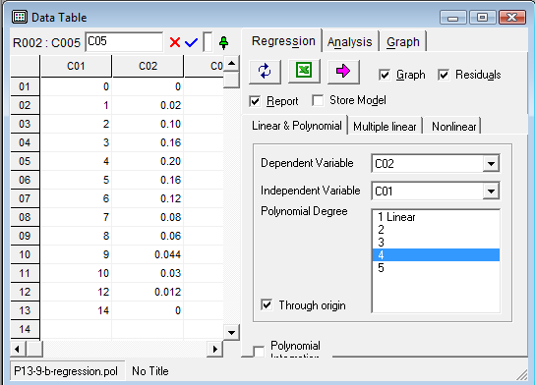
time
E(t)
For the irreversible, liquid-phase, nonelementary rxn A+B→C+D, -r_{A}=kC_{A}C_{B}²
Calculate the X_{A} using the complete segregation model using Polymath
Gave best fit
E(t) = 0 at t=0
Model: C02= a1*C01 + a2*C01^2 + a3*C01^3 + a4*C01^4
a1=0.0889237
a2= -0.0157181
a3= 0.0007926
a4= -8.63E-06
Final Equation: E= 0.0889237*t -0.0157181*t² + 0.0007926*t³ – 8.63E-6*t⁴

Slide 18
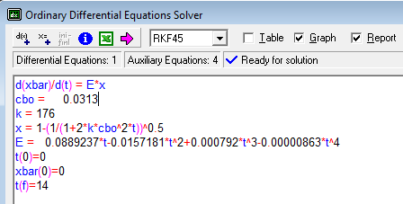
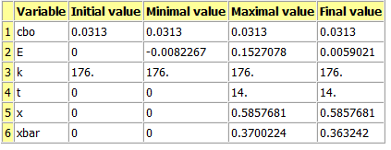
Complete segregation model by Polymath
A+B→C+D
-r_{A}=kC_{A}C_{B}²
Segregation model by Polymath:

Slide 19
For a pulse tracer expt, the effluent concentration C(t) & RTD function E(t) are given
in the table below. The irreversible, liquid-phase, nonelementary rxn A+B→C+D, -r_{A}=kC_{A}C_{B}² will be carried out isothermally at 320K in this reactor. Calculate the conversion for an ideal PFR, the complete segregation model and maximum mixedness model. C_{A0}=C_{B0}=0.0313 mol/L & k=176 L²/mol²·min at 320K
t min | 0 | 1 | 2 | 3 | 4 | 5 | 6 | 7 | 8 | 9 | 10 | 12 | 14
C g/m³ | 0 | 1 | 5 | 8 | 10 | 8 | 6 | 4 | 3 | 2.2 | 1.5 | 0.6 | 0
E(t) | 0 | 0.02 | 0.1 | 0.16 | 0.2 | 0.16 | 0.12 | 0.08 | 0.06 | 0.044 | 0.03 | 0.012 | 0
Maximum mixedness model:
λ=time
F(λ) is a cumulative distribution function
Polymath cannot solve because λ→0 (needs to increase)
Substitute λ for z, where z=T̅-λ where T̅=longest time interval (14 min)
E must be in terms of T̅-z. Since T̅-z=λ & λ=t, simply substitute λ for t
E(λ)= 0.0889237*λ-0.0157181*λ² + 0.0007926*λ³ – 8.63E-6*λ⁴

Slide 20
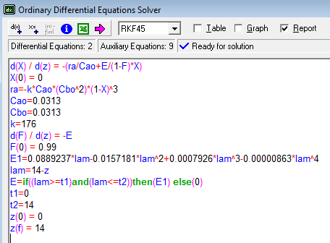
Maximum Mixedness Model, nonelementary reaction A+B→C+D
-r_{A}=kC_{A}C_{B}²
Denominator cannot = 0
Eq for E describes RTD function only on interval t= 0 to 14 minutes, otherwise E=0
X_{A, maximum mixedness} = 0.347

Slide 21
For a pulse tracer expt, C(t) & E(t) are given in the table below. The irreversible, liquid-phase, nonelementary rxn A+B→C+D, -r_{A}=kC_{A}C_{B}² will be carried out in this reactor. Calculate the conversion for the complete segregation model under adiabatic conditions with T₀= 288K, C_{A0}=C_{B0}=0.0313 mol/L, k=176 L²/mol²·min at 320K, ΔH°_{RX}=-40000 cal/mol, E/R =3600K, C_{PA}=C_{PB}=20cal/mol·K & C_{PC}=C_{PD}=30 cal/mol·K
t min | 0 | 1 | 2 | 3 | 4 | 5 | 6 | 7 | 8 | 9 | 10 | 12 | 14
C g/m³ | 0 | 1 | 5 | 8 | 10 | 8 | 6 | 4 | 3 | 2.2 | 1.5 | 0.6 | 0
E(t) | 0 | 0.02 | 0.1 | 0.16 | 0.2 | 0.16 | 0.12 | 0.08 | 0.06 | 0.044 | 0.03 | 0.012 | 0
Polymath eqs for segregation model:
E(t)= 0.0889237*t -0.0157181*t² + 0.0007926*t³ – 8.63E-6*t⁴
Express k as function of T:
Need equations from energy balance. For adiabatic operation:

Slide 22
For a pulse tracer expt, C(t) & E(t) are given in the table below. The irreversible, liquid-phase, nonelementary rxn A+B→C+D, -r_{A}=kC_{A}C_{B}² will be carried out in this reactor. Calculate the conversion for the complete segregation model under adiabatic conditions with T₀= 288K, C_{A0}=C_{B0}=0.0313 mol/L, k=176 L²/mol²·min at 320K, ΔH°_{RX}=-40000 cal/mol, E/R =3600K, C_{PA}=C_{PB}=20cal/mol·K & C_{PC}=C_{PD}=30 cal/mol·K
t min | 0 | 1 | 2 | 3 | 4 | 5 | 6 | 7 | 8 | 9 | 10 | 12 | 14
C g/m³ | 0 | 1 | 5 | 8 | 10 | 8 | 6 | 4 | 3 | 2.2 | 1.5 | 0.6 | 0
E(t) | 0 | 0.02 | 0.1 | 0.16 | 0.2 | 0.16 | 0.12 | 0.08 | 0.06 | 0.044 | 0.03 | 0.012 | 0
Energy balance for adiabatic operation:
Not zero!
E(t)= 0.0889237*t -0.0157181*t² + 0.0007926*t³ – 8.63E-6*t⁴

Slide 23
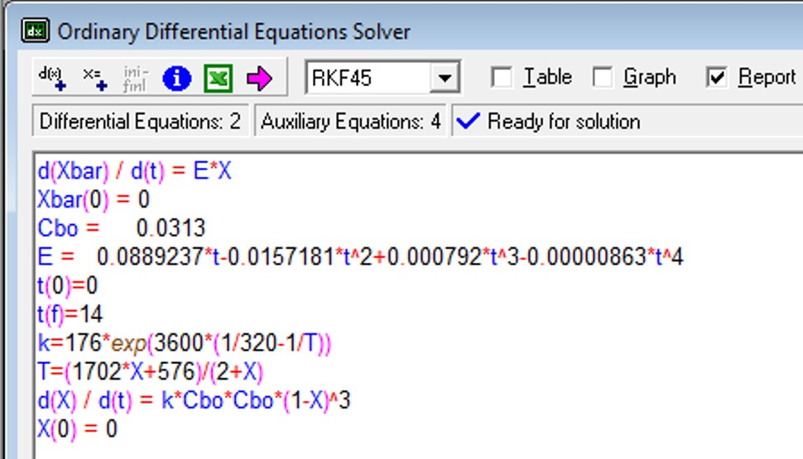
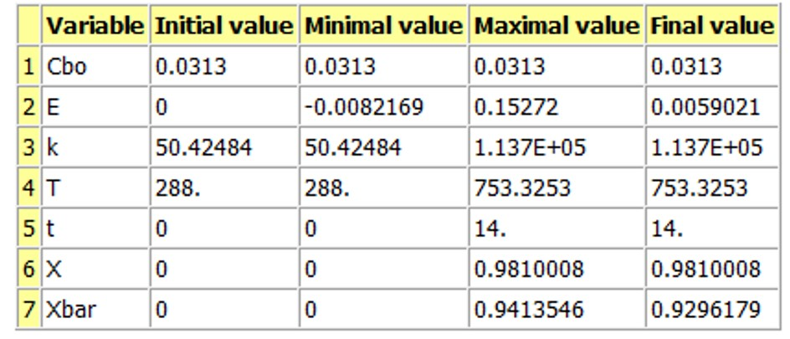
Segregation model, adiabatic operation, nonelementary reaction kinetics
A+B→C+D
-r_{A}=kC_{A}C_{B}²

Slide 24
The following slides show how the same problem would be solved and the solutions would differ if the reaction rate was still -r_{A}=kC_{A}C_{B}² but the reaction was instead elementary: A+2B→C+D
These slides may be provided as an extra example problem that the students may study on there own if time does not permit doing it in class.

Slide 25
For a pulse tracer expt, the effluent concentration C(t) & RTD function E(t) are given
in the table below. The irreversible, liquid-phase, elementary rxn A+2B→C+D, -r_{A}=kC_{A}C_{B}² will be carried out isothermally at 320K in this reactor. Calculate the conversion for an ideal PFR, the complete segregation model and maximum mixedness model. C_{A0}=C_{B0}=0.0313 mol/L & k=176 L²/mol²·min at 320K
t min | 0 | 1 | 2 | 3 | 4 | 5 | 6 | 7 | 8 | 9 | 10 | 12 | 14
C g/m³ | 0 | 1 | 5 | 8 | 10 | 8 | 6 | 4 | 3 | 2.2 | 1.5 | 0.6 | 0
E(t) | 0 | 0.02 | 0.1 | 0.16 | 0.2 | 0.16 | 0.12 | 0.08 | 0.06 | 0.044 | 0.03 | 0.012 | 0
Start with PFR design eq & see how far can we get:
C_{B0} = 0.0313
k = 0.0313
Could solve with Polymath if we knew the value of τ

Slide 26
For a pulse tracer expt, the effluent concentration C(t) & RTD function E(t) are given
in the table below. The irreversible, liquid-phase, elementary rxn A+2B→C+D, -r_{A}=kC_{A}C_{B}² will be carried out isothermally at 320K in this reactor. Calculate the conversion for an ideal PFR, the complete segregation model and maximum mixedness model. C_{A0}=C_{B0}=0.0313 mol/L & k=176 L²/mol²·min at 320K
t min | 0 | 1 | 2 | 3 | 4 | 5 | 6 | 7 | 8 | 9 | 10 | 12 | 14
C g/m³ | 0 | 1 | 5 | 8 | 10 | 8 | 6 | 4 | 3 | 2.2 | 1.5 | 0.6 | 0
E(t) | 0 | 0.02 | 0.1 | 0.16 | 0.2 | 0.16 | 0.12 | 0.08 | 0.06 | 0.044 | 0.03 | 0.012 | 0
t min | 0 | 1 | 2 | 3 | 4 | 5 | 6 | 7 | 8 | 9 | 10 | 12 | 14
C g/m³ | 0 | 1 | 5 | 8 | 10 | 8 | 6 | 4 | 3 | 2.2 | 1.5 | 0.6 | 0
E(t) | 0 | 0.02 | 0.1 | 0.16 | 0.2 | 0.16 | 0.12 | 0.08 | 0.06 | 0.044 | 0.03 | 0.012 | 0
t*E(t) | 0 | 0.02 | 0.2 | 0.48 | 0.8 | 0.8 | 0.72 | 0.56 | 0.48 | 0.396 | 0.3 | 0.144 | 0
How do we determine τ?
For an ideal reactor, τ = t_{m}
Use numerical method to determine t_{m}:

Slide 27
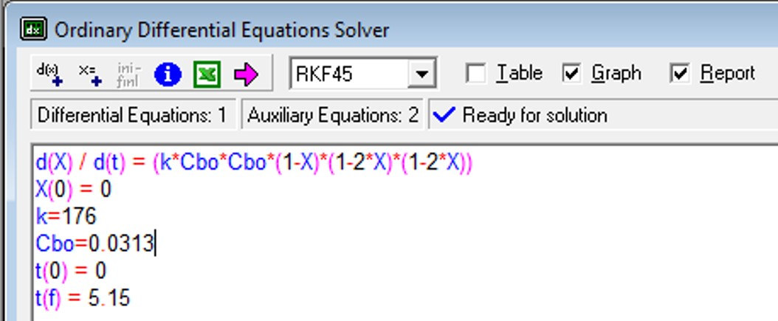
For a pulse tracer expt, the effluent concentration C(t) & RTD function E(t) are given
in the table below. The irreversible, liquid-phase, elementary rxn A+2B→C+D, -r_{A}=kC_{A}C_{B}² will be carried out isothermally at 320K in this reactor. Calculate the conversion for an ideal PFR, the complete segregation model and maximum mixedness model. C_{A0}=C_{B0}=0.0313 mol/L & k=176 L²/mol²·min at 320K
t min | 0 | 1 | 2 | 3 | 4 | 5 | 6 | 7 | 8 | 9 | 10 | 12 | 14
C g/m³ | 0 | 1 | 5 | 8 | 10 | 8 | 6 | 4 | 3 | 2.2 | 1.5 | 0.6 | 0
E(t) | 0 | 0.02 | 0.1 | 0.16 | 0.2 | 0.16 | 0.12 | 0.08 | 0.06 | 0.044 | 0.03 | 0.012 | 0
t min | 0 | 1 | 2 | 3 | 4 | 5 | 6 | 7 | 8 | 9 | 10 | 12 | 14
C g/m³ | 0 | 1 | 5 | 8 | 10 | 8 | 6 | 4 | 3 | 2.2 | 1.5 | 0.6 | 0
E(t) | 0 | 0.02 | 0.1 | 0.16 | 0.2 | 0.16 | 0.12 | 0.08 | 0.06 | 0.044 | 0.03 | 0.012 | 0
t*E(t) | 0 | 0.02 | 0.2 | 0.48 | 0.8 | 0.8 | 0.72 | 0.56 | 0.48 | 0.396 | 0.3 | 0.144 | 0
For an ideal reactor, τ = t_{m}
Final X_{A} corresponds to τ=5.15 min

Slide 28
For a pulse tracer expt, the effluent concentration C(t) & RTD function E(t) are given
in the table below. The irreversible, liquid-phase, elementary rxn A+2B→C+D, -r_{A}=kC_{A}C_{B}² will be carried out isothermally at 320K in this reactor. Calculate the conversion for an ideal PFR, the complete segregation model and maximum mixedness model. C_{A0}=C_{B0}=0.0313 mol/L & k=176 L²/mol²·min at 320K
t min | 0 | 1 | 2 | 3 | 4 | 5 | 6 | 7 | 8 | 9 | 10 | 12 | 14
C g/m³ | 0 | 1 | 5 | 8 | 10 | 8 | 6 | 4 | 3 | 2.2 | 1.5 | 0.6 | 0
E(t) | 0 | 0.02 | 0.1 | 0.16 | 0.2 | 0.16 | 0.12 | 0.08 | 0.06 | 0.044 | 0.03 | 0.012 | 0
Segregation model with Polymath:
X_{A}(t) is from batch reactor design eq
Batch reactor design eq:
Stoichiometry:
Best-fit polynomial line for E(t) vs t calculated by Polymath (slide 19)
k=176
C_{B0}=0.0313
E(t)= 0.0889237*t -0.0157181*t² + 0.0007926*t³ – 8.63E-6*t⁴

Slide 29
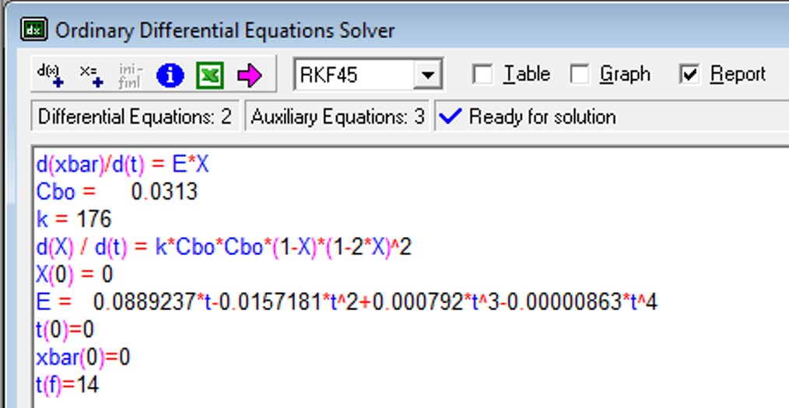
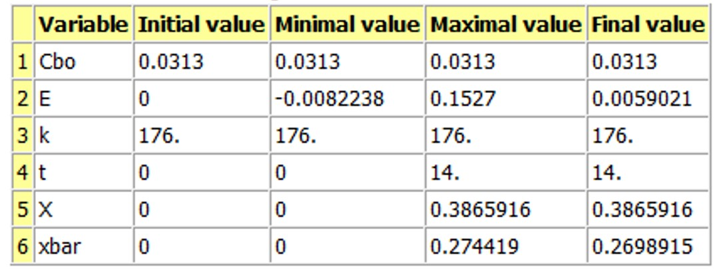
Segregation model, isothermal operation, elementary rxn: A+2B→C+D

Slide 30
For a pulse tracer expt, the effluent concentration C(t) & RTD function E(t) are given
in the table below. The irreversible, liquid-phase, elementary rxn A+2B→C+D, -r_{A}=kC_{A}C_{B}² will be carried out isothermally at 320K in this reactor. Calculate the conversion for an ideal PFR, the complete segregation model and maximum mixedness model. C_{A0}=C_{B0}=0.0313 mol/L & k=176 L²/mol²·min at 320K
t min | 0 | 1 | 2 | 3 | 4 | 5 | 6 | 7 | 8 | 9 | 10 | 12 | 14
C g/m³ | 0 | 1 | 5 | 8 | 10 | 8 | 6 | 4 | 3 | 2.2 | 1.5 | 0.6 | 0
E(t) | 0 | 0.02 | 0.1 | 0.16 | 0.2 | 0.16 | 0.12 | 0.08 | 0.06 | 0.044 | 0.03 | 0.012 | 0
Maximum mixedness model:
λ=time
Polymath cannot solve because λ→0 (must increase)
Substitute λ for z, where z=T̅-λ where T̅=longest time interval (14 min)
E must be in terms of T̅-z. Since T̅-z=λ & λ=t, simply substitute λ for t
E(λ)= 0.0889237*λ-0.0157181*λ² + 0.0007926*λ³ – 8.63E-6*λ⁴

Slide 31
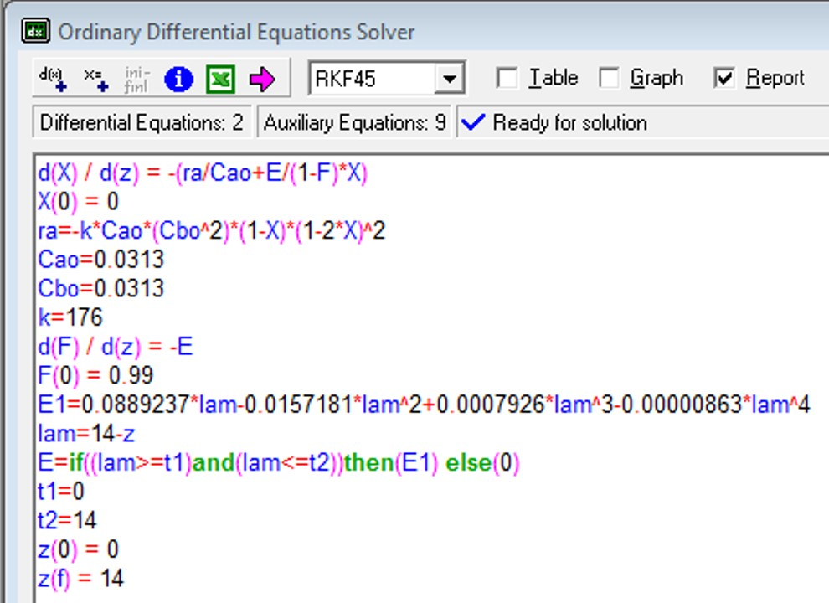
Maximum Mixedness Model, elementary reaction A+2B→C+D, -r_{A}=kC_{A}C_{B}²
Denominator cannot = 0
Eq for E describes RTD function only on interval t= 0 to 14 minutes, otherwise E=0
X_{A, maximum mixedness} = 0.25

Slide 32
For a pulse tracer expt, C(t) & E(t) are given in the table below. The irreversible, liquid-phase, elementary rxn A+2B→C+D, -r_{A}=kC_{A}C_{B}² will be carried out in this reactor. Calculate the conversion for the complete segregation model under adiabatic conditions with T₀= 288K, C_{A0}=C_{B0}=0.0313 mol/L, k=176 L²/mol²·min at 320K, ΔH°_{RX}=-40000 cal/mol, E/R =3600K, C_{PA}=C_{PB}=20cal/mol·K & C_{PC}=C_{PD}=30 cal/mol·K
t min | 0 | 1 | 2 | 3 | 4 | 5 | 6 | 7 | 8 | 9 | 10 | 12 | 14
C g/m³ | 0 | 1 | 5 | 8 | 10 | 8 | 6 | 4 | 3 | 2.2 | 1.5 | 0.6 | 0
E(t) | 0 | 0.02 | 0.1 | 0.16 | 0.2 | 0.16 | 0.12 | 0.08 | 0.06 | 0.044 | 0.03 | 0.012 | 0
Polymath eqs for segregation model:
E(t)= 0.0889237*t -0.0157181*t² + 0.0007926*t³ – 8.63E-6*t⁴
Express k as function of T:
Need equations from energy balance. For adiabatic operation:

Slide 33
For a pulse tracer expt, C(t) & E(t) are given in the table below. The irreversible, liquid-phase, elementary rxn A+2B→C+D, -r_{A}=kC_{A}C_{B}² will be carried out in this reactor. Calculate the conversion for the complete segregation model under adiabatic conditions with T₀= 288K, C_{A0}=C_{B0}=0.0313 mol/L, k=176 L²/mol²·min at 320K, ΔH°_{RX}=-40000 cal/mol, E/R =3600K, C_{PA}=C_{PB}=20cal/mol·K & C_{PC}=C_{PD}=30 cal/mol·K
t min | 0 | 1 | 2 | 3 | 4 | 5 | 6 | 7 | 8 | 9 | 10 | 12 | 14
C g/m³ | 0 | 1 | 5 | 8 | 10 | 8 | 6 | 4 | 3 | 2.2 | 1.5 | 0.6 | 0
E(t) | 0 | 0.02 | 0.1 | 0.16 | 0.2 | 0.16 | 0.12 | 0.08 | 0.06 | 0.044 | 0.03 | 0.012 | 0
Adiabatic EB:
E(t)= 0.0889237*t -0.0157181*t² + 0.0007926*t³ – 8.63E-6*t⁴

Slide 34
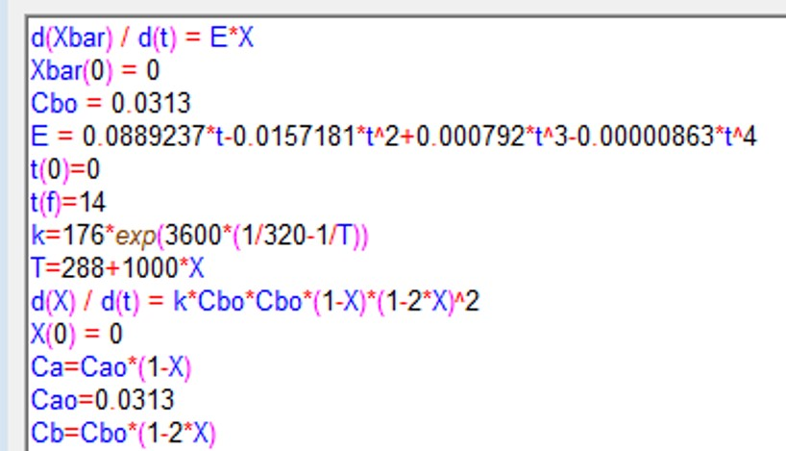
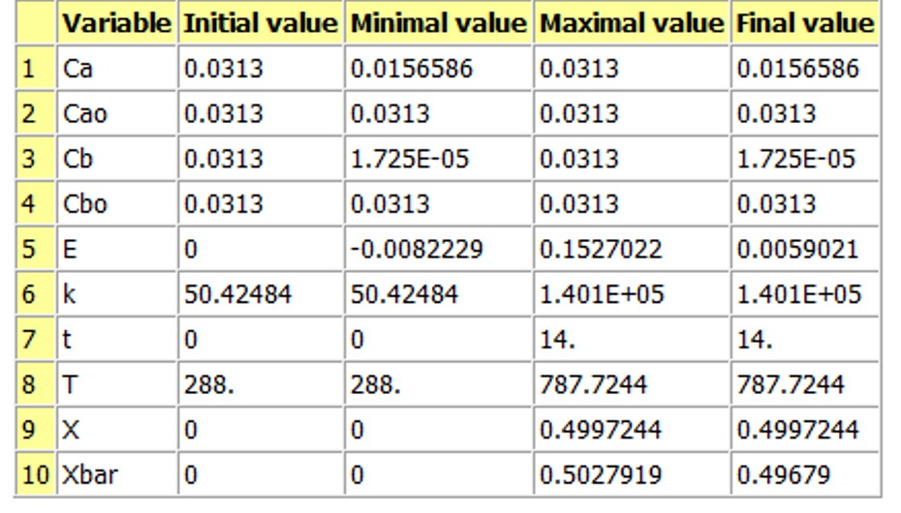
Segregation model, adiabatic operation, elementary reaction kinetics
A+2B→C+D
-r_{A}=kC_{A}C_{B}²
Because B is completely consumed by X_{A}=0.5
X̅_{A} = 0.50
Why so much lower than before?

